Slide 1
Cyber-Physical Systems
Indoor Localization and Navigation using transformers
10th August,2023

Slide 2
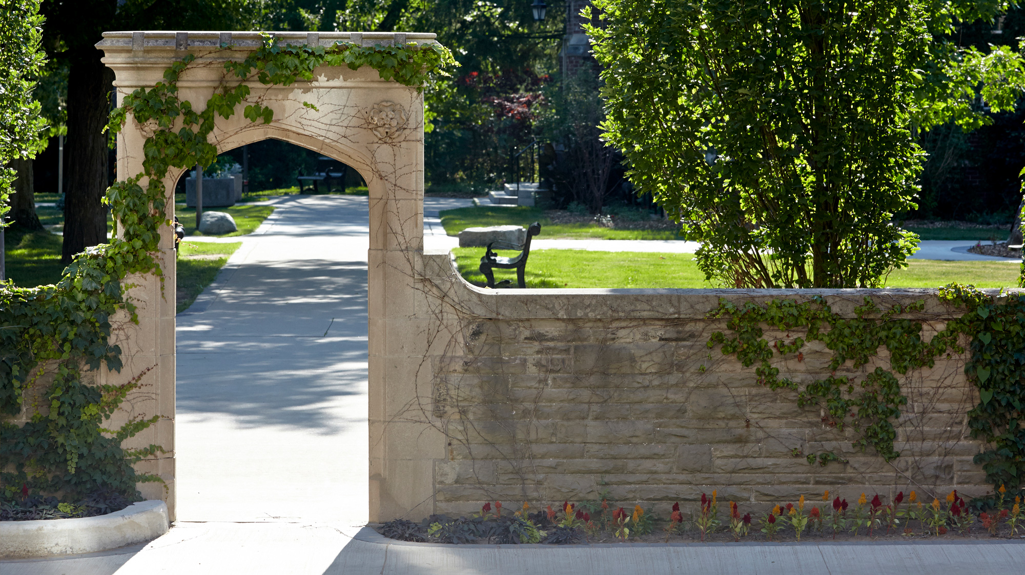

Housuke KhanhVD Kouki Minh Tri Phan Darich
Contributors
Special Shout it out to the below authors for their notebook[1]:
housuke (Owner)
KhanhVD (Viewer)
Kouki (Viewer)
Minh Tri Phan (Viewer)
darich (Viewer)
Submitted to:
Anwar M. Mirza
Submitted by:
Ankur Bassi
Tithi Patel
Harsh
[1] https://www.kaggle.com/code/horsek/iln-x-y-training-and-inference-part-no-pp
Notes:
I am Tithi Patel with my team members Ankur Bassi and Harsh Patel. We have worked on the Project named Indoor Location and navigation system and would like to show gratitude to our professor Dr. Anwar Majid Mirza who provided us with this opportunity. While working on the executing plan we would like to provide great thanks to the authors of kaggle note book whose NOTEBOOK has been boiler plate for our code execution and implementation.

Slide 3
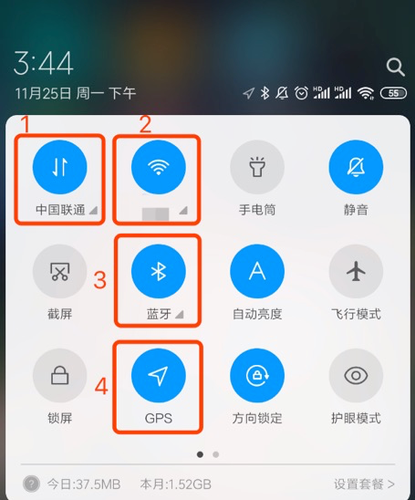
Dataset
Site Features
Total 24 sites( 24 Malls in China)
9 floors(B1,B2,F1,F2,F3,F4,F5,F6,F7F8,F9)
Sensor Data
Accelerometer
MAGNETIC_FIELD
GYROSCOPE
WIFI
BEACON
Ground Truth
Waypoint Coordinates: X,Y
Notes:
Our project’s aim is to predict position of smartphones based on the real time sensor data, provided by indoor positioning technology company XYZ10 in partnership with Microsoft Research. The main task is to predict the floor and waypoint at specific time provided in the file named submission.csv from the existing data of site path file.
This project can be implemented in real time in different malls as well as different industries. Here we have implemented the requirements on the dataset from the real malls of China.
LET’S get started with the understanding of the project as well as dataset.
Initially we had data of 24 site(All of them are of the malls in China). RepresentatioN of the Floors are (B1,B2,F1,F2,F3,F4,F5,F6,F7,F8,F9) apart from floor we have few sensory data which are provide through Android( Accelometer, Magnatic Field, Gyroscope, Wifi Beacon)
Utilising all the above data we have to get following ground truth that is waypoint which represents the actual co-ordinates of the smartphone (X,Y).

Slide 4
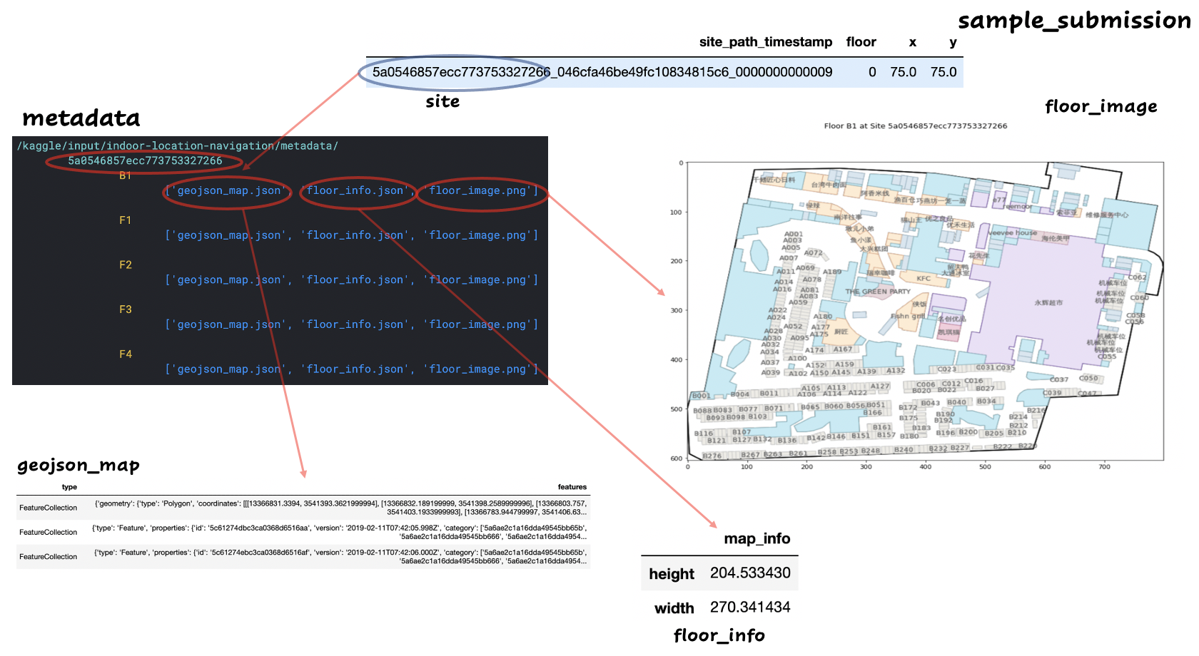
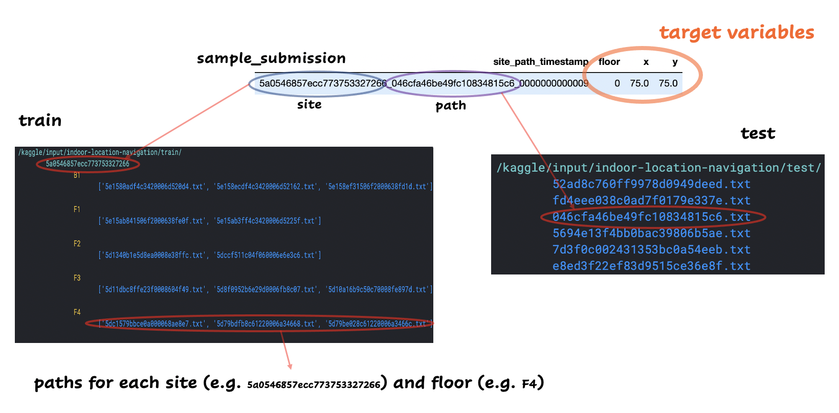
Notes:
Here is the sample submission file which mainly represents meta data such as geojson map followed by the information of the floor, and floor image.

Slide 5
Trace File (Raw Data)
Trace File includes:
Meta Info
Sensor Information
Meta Info
A person travels a particular path on a specific floor of the site:
For Single Path, we have multiple files having information according to the timestamp
Each Trace File contains sensor information at a particular timestamp
Notes:
This file includes Meta information as well as sensor information.
Going through the information here are the waypoints as well as the values of x, y, z axis with a constant which represents accuracy.
Few of the sensor’s have 6 values 2 sets of 3 different axis and those are the uncalibrated .
Main difference between calibrated and uncalibrated is that calibrated sensor details are the final details after ignoring the interference whereas uncalibrated values shows the actual values of co-ordinate as well as the values which are different due to the interference of the external object.
For Wifi the value starting with 5 represents 5G and 4 represents 4G and similar to 2G as well as 3 G etc.

Slide 6

Sensor Information
TimeStamp
Sensor Type
Sensor Information
TimeStamp
Sensor Type
Sensor Information

Slide 7
Preprocessing
Creating Features
Types of Information we can make out from data include
Site Information: Site ID
Wi-Fi Information: Wi-Fi ID, Wi-Fi signal strength
IMU (Inertial Measurement Unit) Information: Magnetometer, Accelerometer, Gyroscope
Walking Length information: stride length from starting position[X Y]
Categorical Features available | Continuous Features available
Site ID | Wifi Signal
Wi-Fi ID | Beacon Signal
 | Accelerometer
 | Gyroscope, Rotation
 | Walking Length
 | Magnetometer
Notes:
Orientation Estimation: IMU data includes information from accelerometers, gyroscopes, and often magnetometers. This information can be used to estimate the orientation of a device (e.g., a smartphone or wearable) relative to the Earth's surface. Knowing the device's orientation helps in understanding how it's moving through space.
Motion Tracking: By analyzing changes in acceleration and rotational rate from the IMU, you can infer how the device (and presumably the person carrying it) is moving. This includes understanding whether the device is stationary, walking, turning, climbing stairs, etc.
Enhancing Other Sensors: IMU data can be fused with other sensors (such as Wi-Fi or Bluetooth signals) to improve positioning accuracy. For example, Wi-Fi might provide a rough position fix, and IMU data could be used to refine that position based on detected movements
Step Information: The code uses accelerometer data and additional sensors to detect individual steps and calculate stride lengths and headings(direction of movement) for each step.
Cumulative Distance: The cumulative walking distance is calculated as the sum of stride lengths over time.
Relative Positions: The relative positions in �X and �Y directions are calculated using the headings and stride lengths, and the cumulative sum represents the total displacement in those directions.

Slide 8
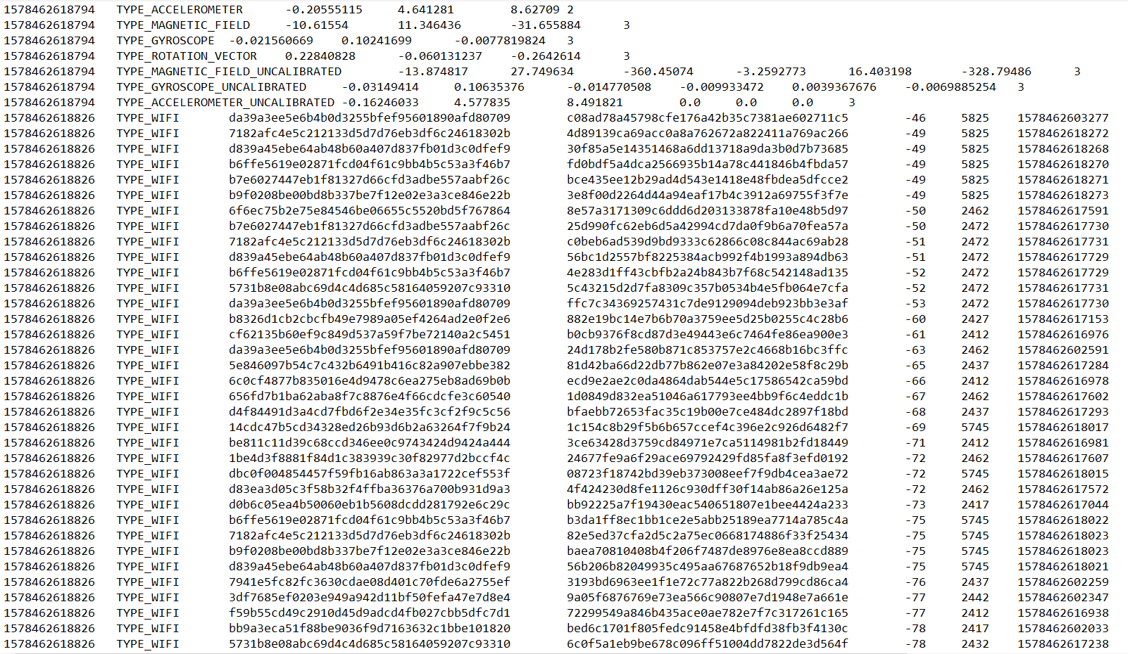
Preprocessing
Top 40 Wi-Fi ID and Wi-Fi Signals
There are more than 100 Wi-Fi signals associated with each path
We extract the top 40 most reliable signals
Leading to 40 Wi-Fi ids and 40 signal strength
80 Features by Far
Notes:
Dimensionality Reduction: Wi-Fi scans can detect many networks, especially in dense urban areas. By selecting the top 40 signals, the system focuses on the most relevant information, reducing the dimensionality of the data.
Noise Reduction: Weaker signals, which are ignored by taking only the top 40, may come from distant access points and contribute noise rather than useful information.
Alignment with Human Movement: Considering the strongest signals might align better with human movements in indoor environments, reflecting the actual paths that people are likely to take
Here we are considering wifi id’s also because later with the help of neural network we will make embeddings that will identify some interdependence between each wifi

Slide 9
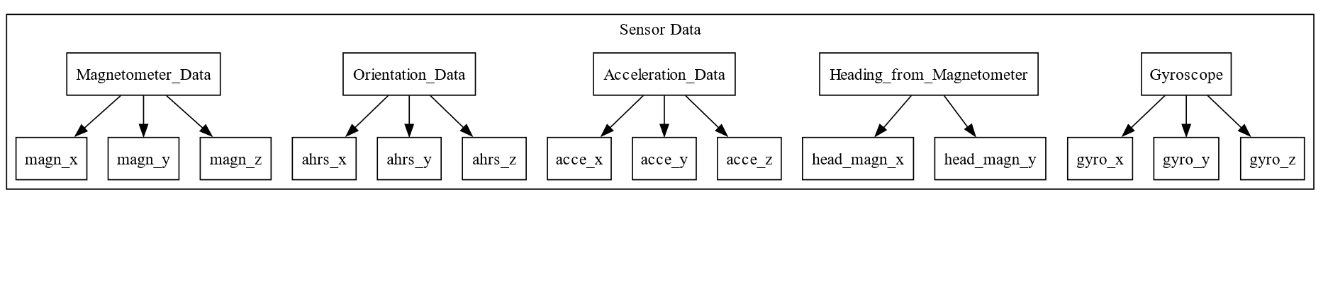
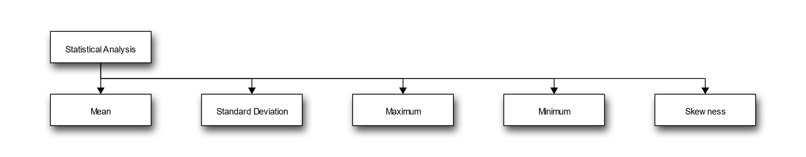
Preprocessing
Features for IMU Statistics
12 Sensor readings and 5 statistical points:
12x5=60 Features more
Notes:
Feature Extraction: By calculating these statistical points, the code is extracting features that capture essential characteristics of the sensor data. This summarization can reveal underlying patterns and trends.
Dimensionality Reduction: Instead of using raw sensor readings, which can be numerous and noisy, summarizing the data with statistical measures reduces the dimensionality, making analysis and modeling more tractable.

Slide 10
Preprocessing
Relative position and Walking Length:
Relative position:
The relative positions represent the cumulative displacement of an object from its starting point, measured in the x and y directions.
The relative position is calculated in both the x and y coordinates
delta_x_hat, delta_y_hat, delta_x_mag, delta_y_mag
four features more
Walking Length
Total Distance covered
1 Feature more
Total Till now=1 site feature+80 Wifi Features+60 IMU Features+4 Relative position+ 1 Walking Length=145
Notes:
While working with different preprocessing here I would like to explain one of the important preprocessing step that is Relative position.
A mall or any indoor unit might have different entrance or have user switched on the navigation application at different location hence the displacement to the initial position will be calculated in terms of x, y co-ordinates.
Basically what function does is takes input data related to the walking path, calculates various step related information heading length and generates the sequence representing time and displacement and its cumulative position.
as Discussed in the earlier slides now we have 146 includes site features, 80 wi-fi feature, 60 IMU features, 4 Relative position and 1 walking length features.

Slide 11
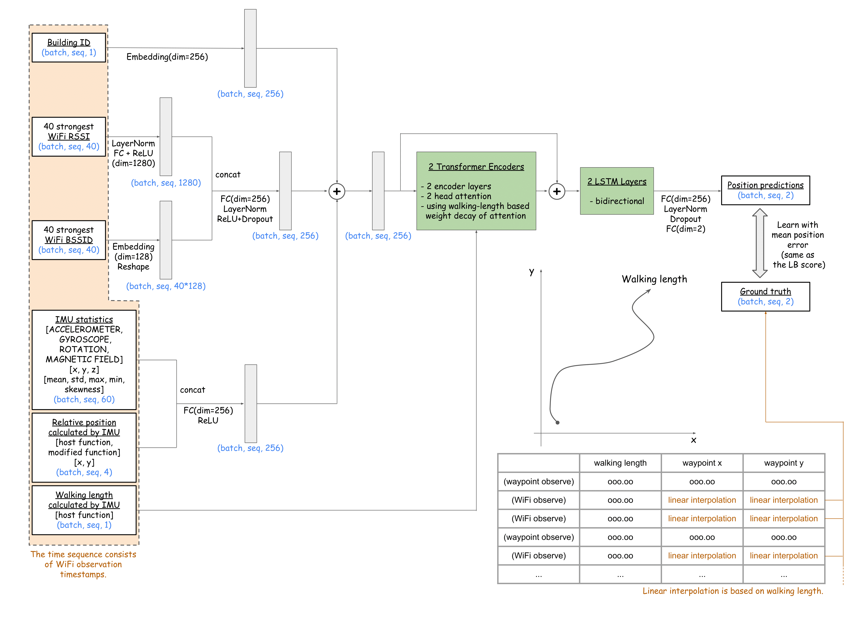
Neural Network Architecture
Site ID: Converted to embeddings with 256-dimension
Wifi ID: Converted to embeddings with 128-dimension
We want to capture relationships between different sites which is why converting to embeddings helps the model learn a continuous representation that can capture more nuanced relationships between different sites.
Similarly, this applies to wifi, where we want to capture interdependent relationships between each wifi.
Notes:
Site ID Embeddings: Site IDs are converted into 256-dimensional embeddings to capture intricate relationships between different sites, enabling a nuanced understanding of locations.
Wi-Fi ID Embeddings: Wi-Fi IDs are transformed into 128-dimensional embeddings, allowing the model to recognize patterns and dependencies in Wi-Fi connectivity.
40 Strongest Wi-Fi Signals: These signals are processed through a fully connected neural network with ReLU activation, resulting in 1280 output neurons.
These 1280 output neurons are concatenated with Wifi Embeddings and passed through fully connected layers providing 256 output neurons
Similarly These 60 IMU dimensions are concatenated with 4 Reltive position discussed earlier and passed through fully connected dense layer to give 256 dim out put
Now all the three 256 output tensors are added to form a single 256 dimension output which is passed through out transformer architecture with 2 encoded and 2 multi head attention layer.
Now the output from transformers is added with the previous input and passed through 2 biderctional Lstm, this ensure that we capture the sequential dependency and hidden relation between
Each feature.
The output from LSTM is out 2 positional coordinates x and y

Slide 12
Loss Function
Positional Difference: The loss function calculates the squared difference between the predicted x, y coordinates and the actual x, y coordinates.
Aggregation: The square root of the squared difference of each example in a batch is calculated and added.
Normalization: The Aggregation is then divided by the total number of examples
Final loss: The above Normalized value is the loss
metr1 = (output[:,:,:2]-label[:,:,:2]).square()
metr1 = metr1.sum(dim=-1)+1e-6
metr1 = metr1.sqrt().sum()
metric = metr1/filter_.sum()
loss = metric
Notes:
Positional Difference: The loss function calculates the squared difference between the predicted x, y coordinates and the actual x, y coordinates.
We calculate the square root or positional difference and add all of them

Slide 13
Hyperparameter tuning and results
Hyperparameters
Site id Embeddings(S_emb)
Wifi Id Embeddings(W_emb)
Number of features to pass to transformers(ninp)
Number of Attention Heads(nAH)
Number of hidden units in transformers feed-forward neural network(nhid)
Epochs

Slide 14
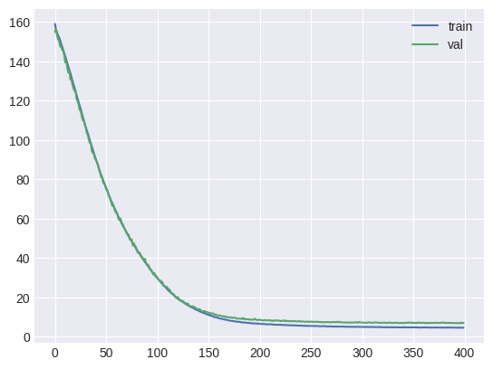
Hyperparameter tuning and results
S_emb | W_emb | ninp | nAH | nhid | Epochs | Validation Loss
256 | 128 | 256 | 2 | 512 | 10 | 170
512 | 256 | 256 | 2 | 512 | 400 | 7.8
256 | 128 | 512 | 4 | 512 | 400 | 8.2
256 | 128 | 512 | 2 | 512 | 400 | 7.1
Hyperparameter tuning table
Loss Graph

Slide 15

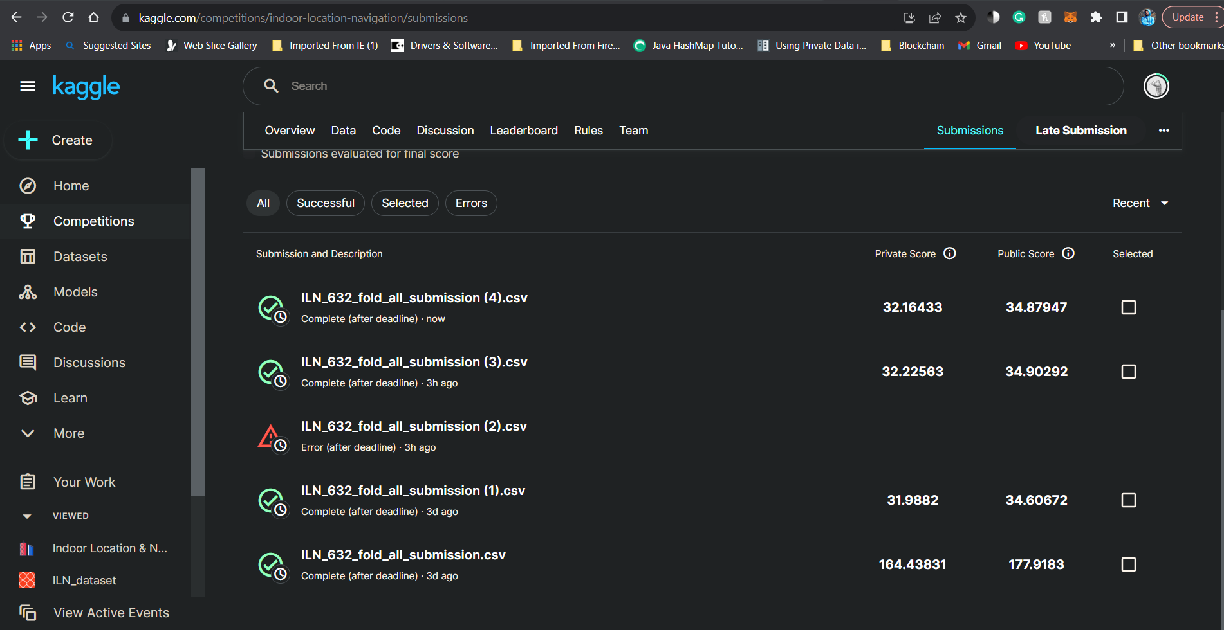
Kaggle Results
Leaderboard vs Ours loss metrics
Leaderboard score
Our score

Slide 16
Reference
https://github.com/location-competition/indoor-location-competition-20
https://www.kaggle.com/c/indoor-location-navigation
https://www.kaggle.com/code/horsek/iln-x-y-training-and-inference-part-no-pp
https://developer.android.com/reference/android/hardware/SensorEvent.html#values
https://www.kaggle.com/code/horsek/iln-preprocess-create-dataset-public/notebook

Slide 17

Ankur Bassi bassia8@mcmaster.ca Tithi Patel patelt77@mcmaster.ca Harsh Patel pateh63@mcmaster.ca

